Slide 1
Challenge 6 Find the device
Team members:
Shisheng wang
xiangtian yi
Ye xing
Yanlin zhou

Slide 2
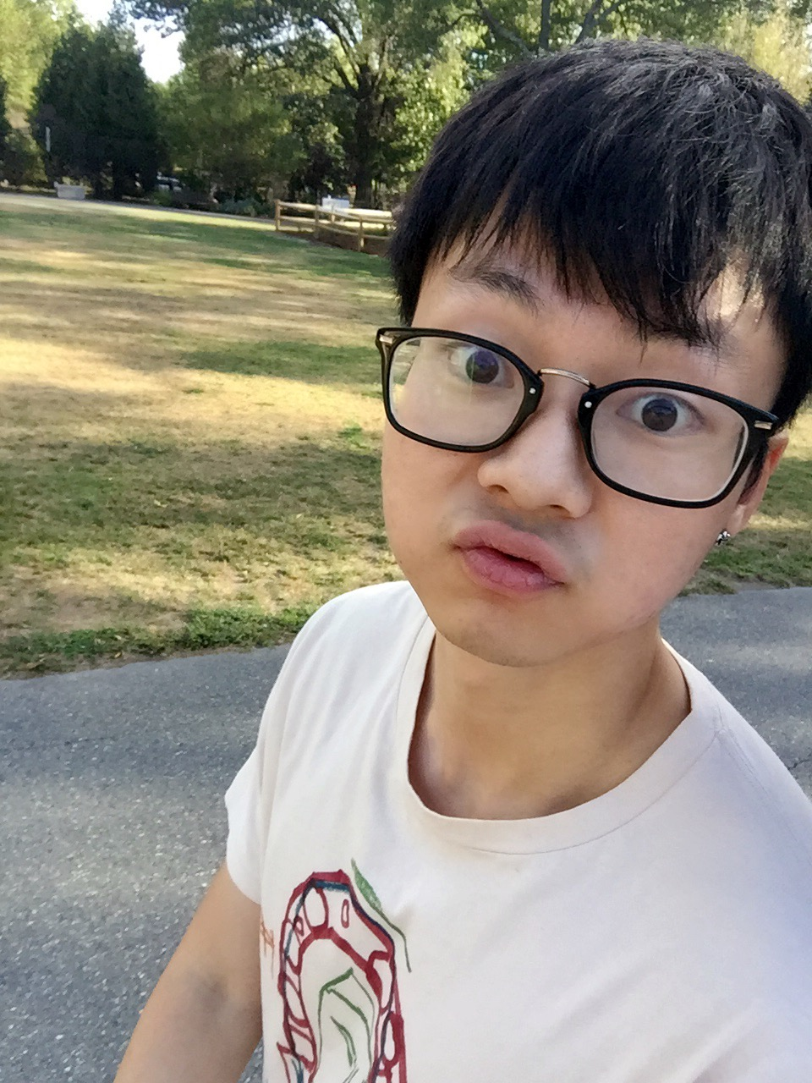
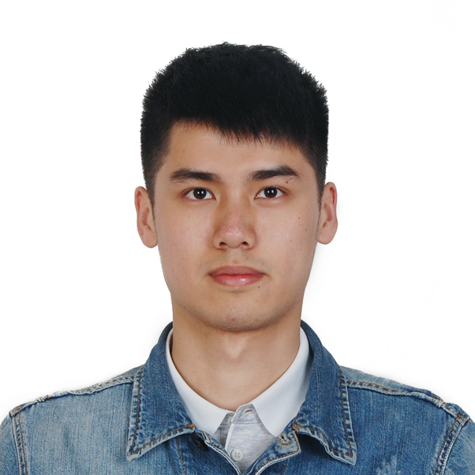
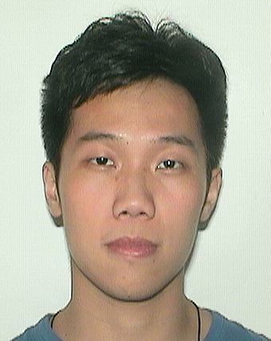
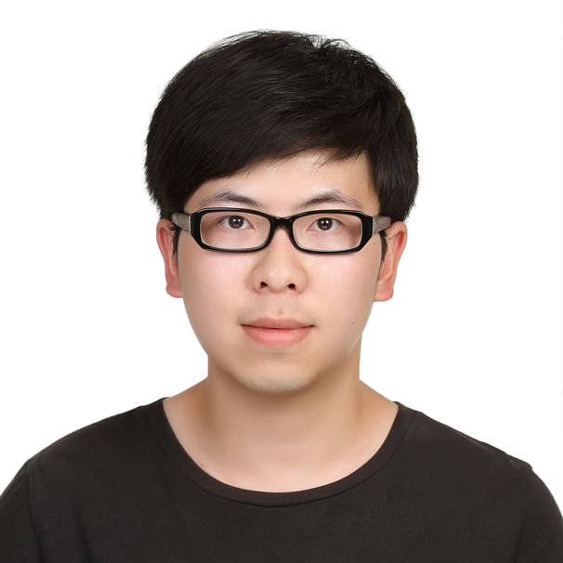
Presenter on this challenge
 | Xiangtian | Shisheng | Ye | Yanlin
Challenge 1 | Presenter
Challenge 2 |  | Presenter
Challenge 3 |  |  | Presenter
Challenge 4 |  |  |  | Presenter
Challenge 5 |  |  | Presenter
Challenge 6 |  | Presenter
Challenge 7
Challenge 8

Slide 3
TEAM WORK
Xiangtian | Shisheng | Ye | Yanlin
I engaged in designing the html to make it receive data more accurately and helped collecting the data. | I set up the coordinator and 4 beacons in XCTU, and wrote the arduino code and engaged in modifying the node.js code. | I designed the js code and used the queues as a cache to minimized the jumpy data. And set up the bound to limit. Engaged in the data collecting part. | I designed and implemented the front-end and engaged in testing and training the datasets.

Slide 4
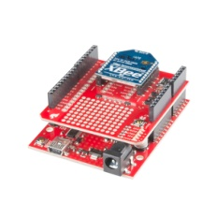
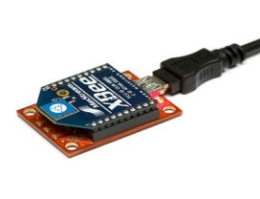
architecture
RSSI
RSSI
Beacon 1
Beacon 3
Coordinator
RSSI
RSSI
Beacon 2
Beacon 4

Slide 5
DESIGN DECISION
Algorithm choose
Compared with other methods, KNN is a better solution for Xbee
Implement it on Raspberry Pi
Use Node.js KNN library to train the dataset and define the location
Front end
Design a map on webpage and use a point to show the location
Jumpy data correction
Use queue to store data and take the average to predict
Record the previous location data and we set a bound to limit the difference between previous and current lower than 1 step.
DDNS
We can access the webpage off BU-network.

Slide 6
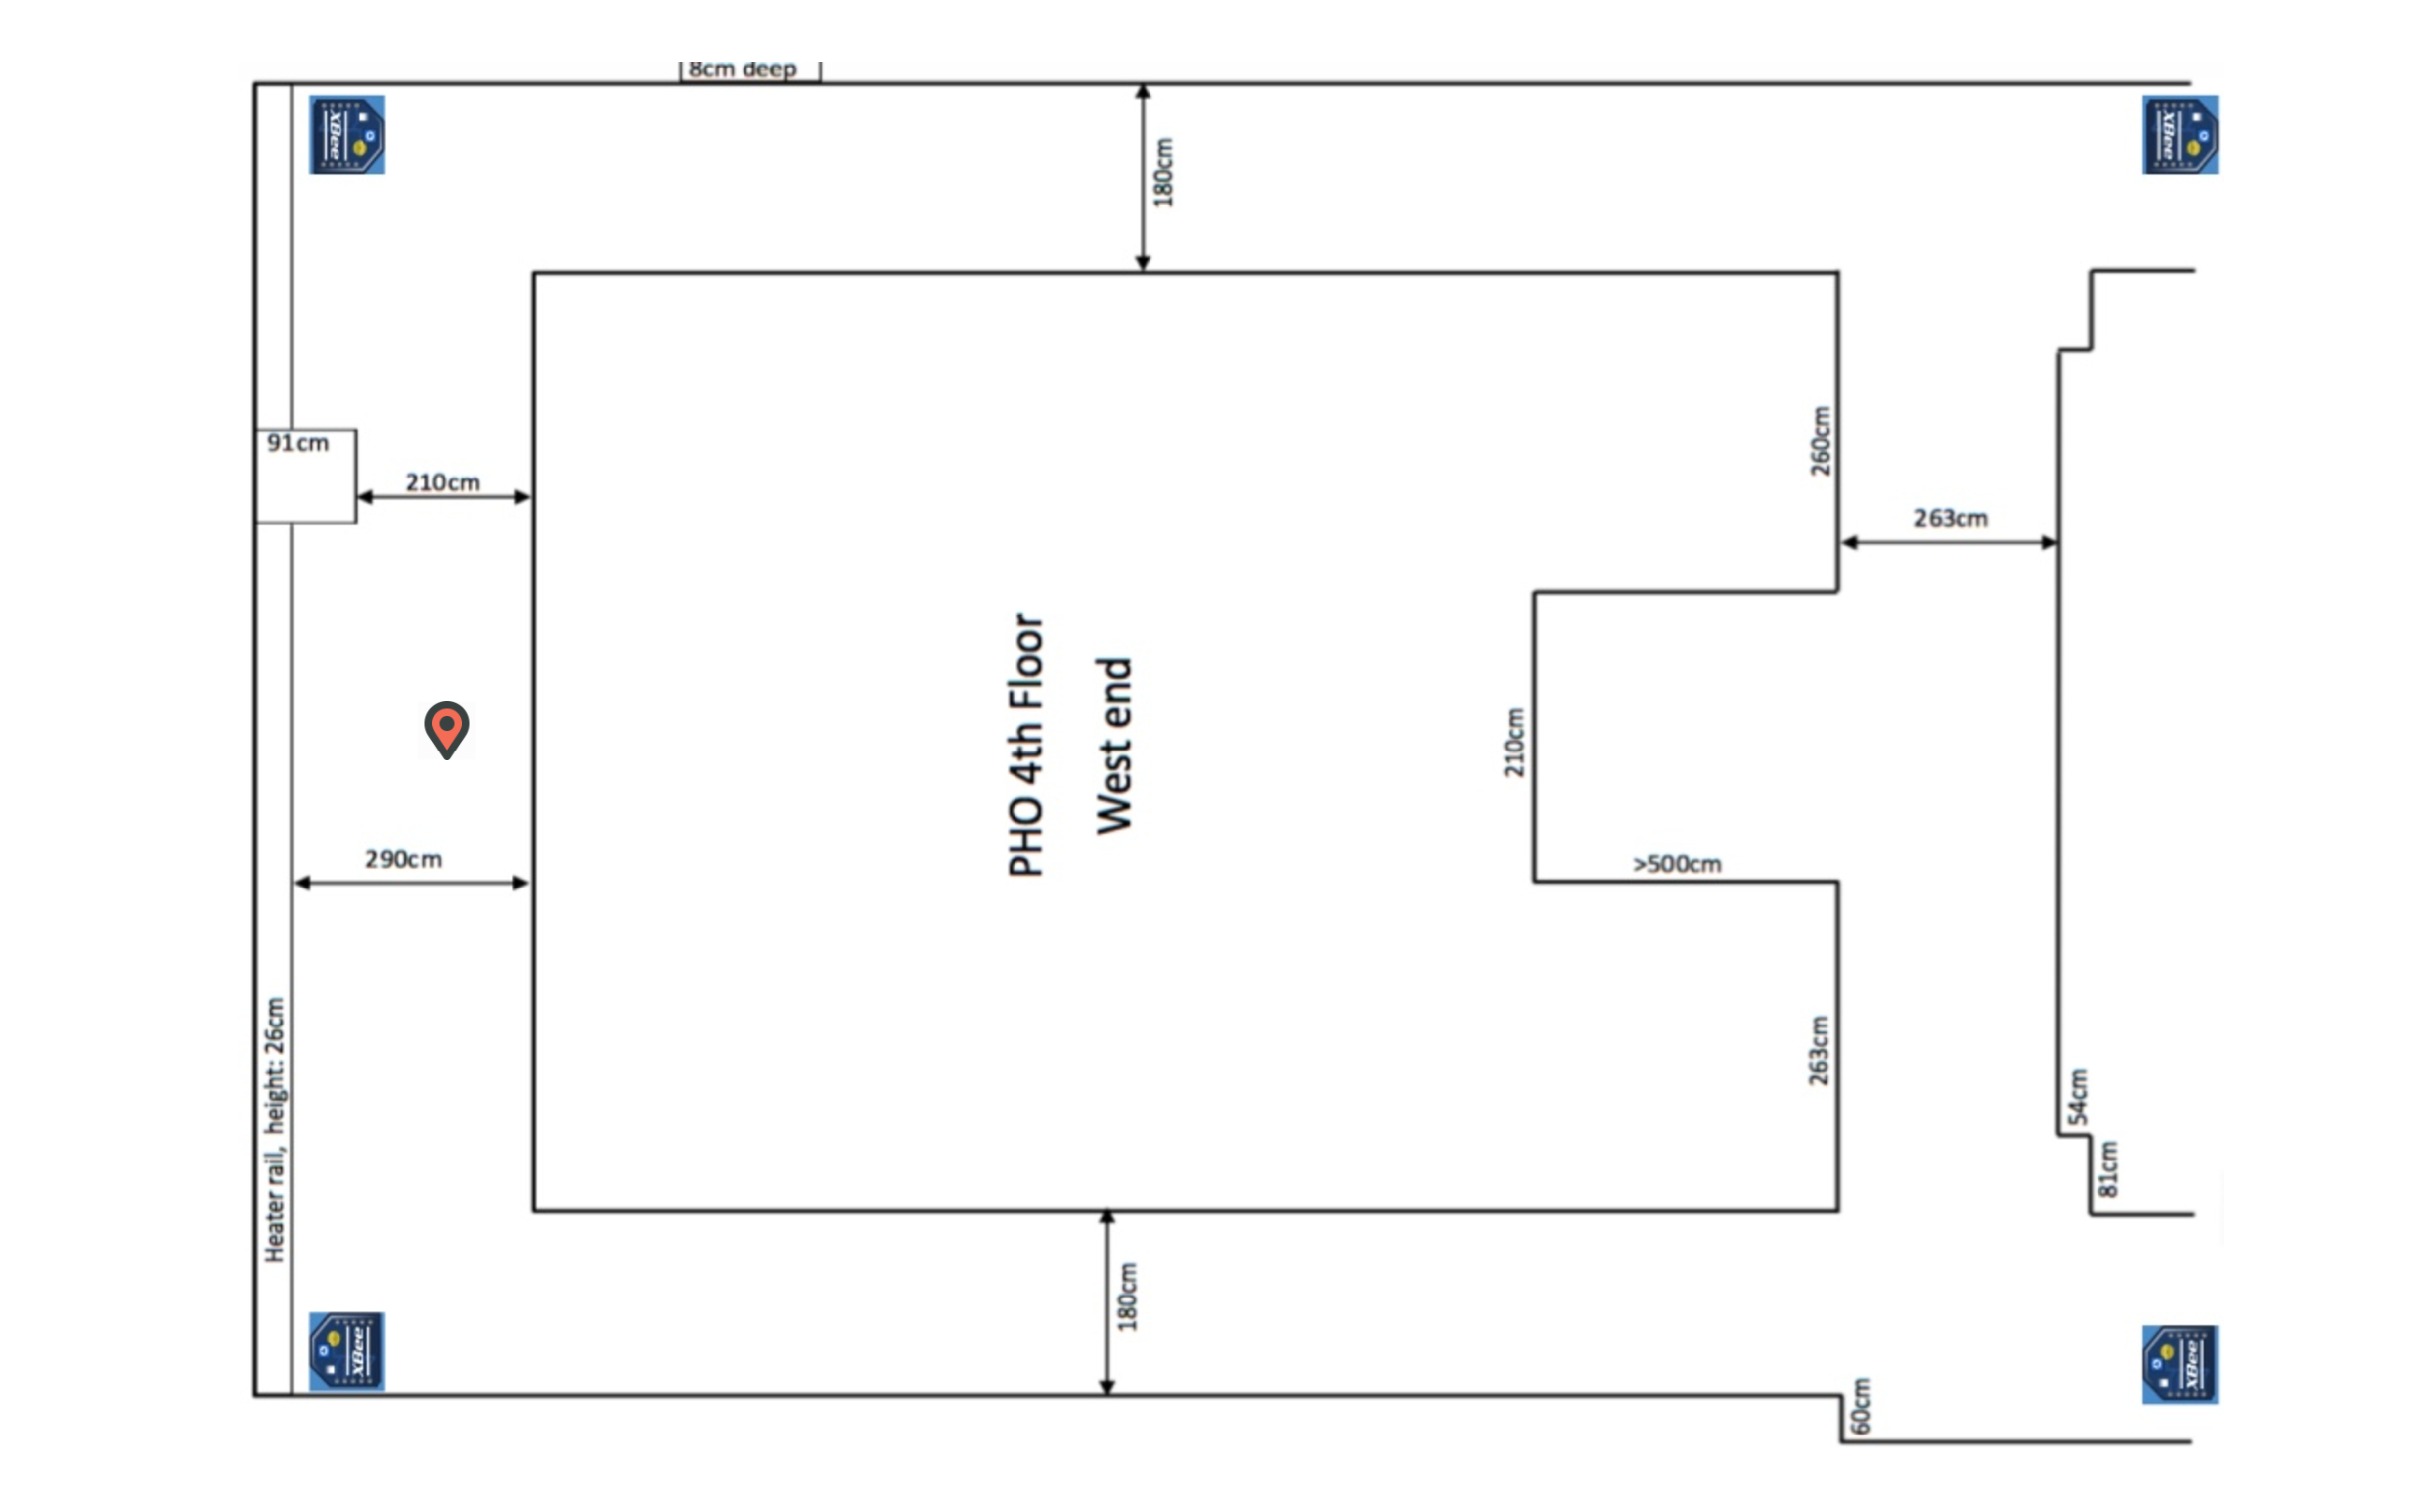
UI DESIGN

Slide 7
Challenges
Train the dataset
Solve the jumpy problems
Set the k value of KNN Algorithm

Slide 8
Future improvements
The accuracy of the location can be improved
The delay can be decreased in future
The jumpy problem can also be improved

Slide 9
Thank you !

